Slide 1
UML Diagrams

Slide 2
Sequence Diagram
It is a dynamic diagram that shows the flow in the application with respect to timing.
Initially, the customer places his order.
The order is confirmed and checked for its type, i.e. , normal or special.
The order is dispatched.

Slide 3
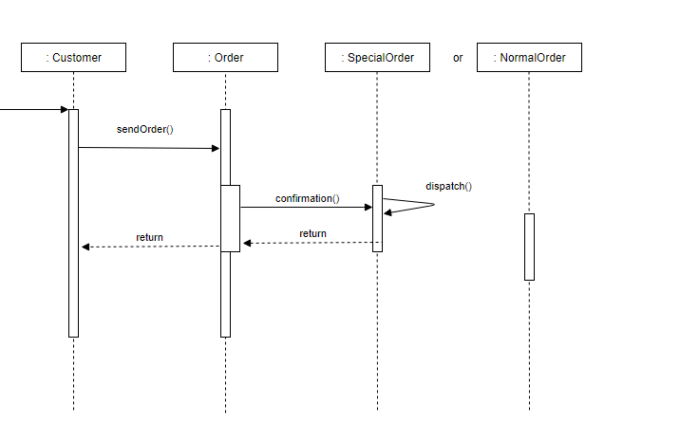

Slide 4
Use Case Diagram
Use case diagram are used for high level requirement analysis of the system.
Given use Case Diagram considers an online shopping system.
The actor is the user who orders a product.
The order is further categorized as specialOrder and normalOrder.

Slide 5
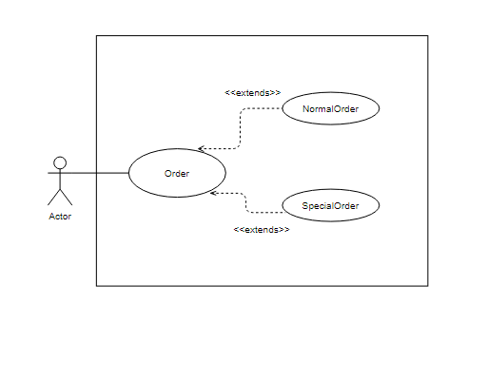

Slide 6
Activity Diagram
Activity diagram is a dynamic diagram. Activity diagram shows the flow of control in the application
The flow begins with the customer placing an order.
Order receipt system confirms the order. The type of the order is checked.
If normal is yes, order is confirmed and then dispatched.
If order is not normal, it is further checked if the order is special, if yes, the order is confirmed, dispatched and terminated.
If the order is neither normal nor special, the process is terminated.

Slide 7
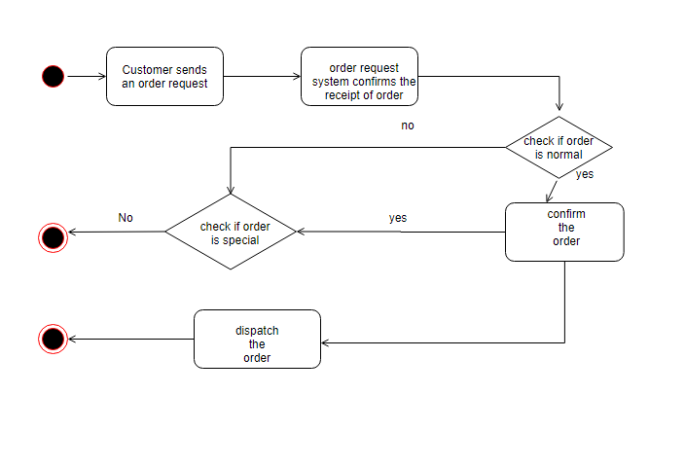

Slide 8
Class Diagram
The class diagram is a static view of the application. It is used for constructing executable code from the UML model.
The given class diagram has four classes – user, order, normalOrder and specialOrder.
The user class is the customer who places the order in the application. There are two attributes of the user class , i.e., name and location. The class methods are sendOrder() and receiveOrder().
The user places his order in the order class. The order class has date and number as attributes. The class methods are confirm() and close().
The other class in the given diagram is NormalOrder. NormalOrder(child class ) inherits from Order class(parent class). All the methods and attributes of Order class are part of NormalOrder as well. Along with them, another method of the class is dispatch().
The forth class is SpecialOrder. It is also child class of Order class. The additional methods of SpecialOrder are dispatch() and receive().

Slide 9
